Slide 1
Basic Concept of file Logger
- Prepared by Shadab Shaikh 17DCO74

Slide 2
Outline
Some Pre-requisite Information
  File?
  Log?
  File logger?
Need of logging
Python Logging Module
Real life scenario

Slide 3
Some Pre-requisite Information
What is a file ?
A file is an object on a computer that stores data, information, settings, or commands used with a computer program. In a GUI (graphical user interface), such as Microsoft Windows, files display as icons that relate to the program that opens the file
What is a log ?
A kind of record of various events done by the user in an orderly manner while using an application.
What is a file logger ?
Combination of both of the concepts. Meaning we store the log in a file more precisely a .txt file

Slide 4
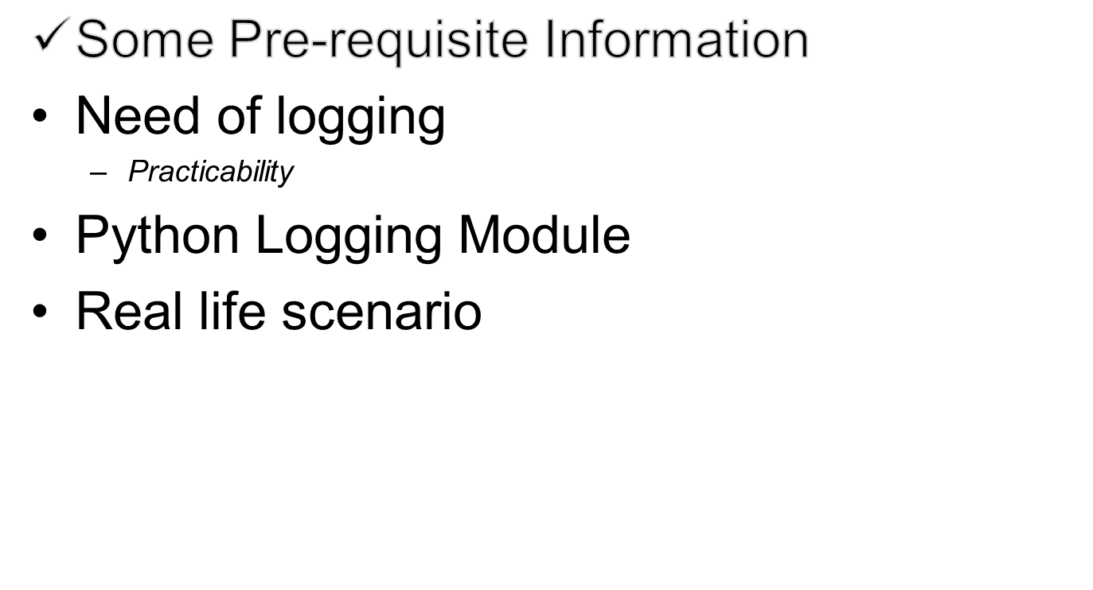
Progress

Slide 5
Practical Application and essence of logging
Programming - To get the overview of events in a much larger scale
Security & backup

Slide 6
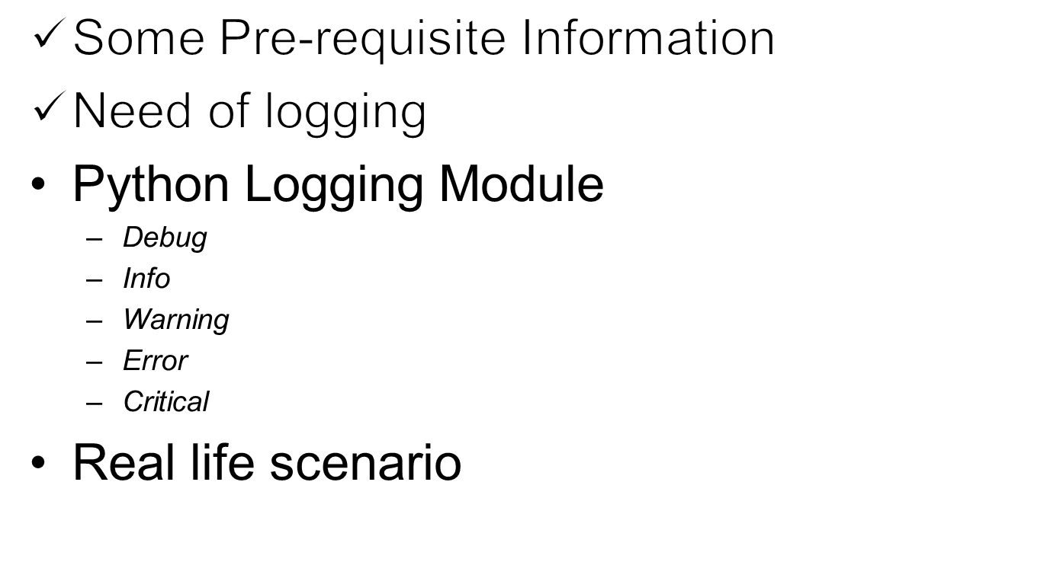
Progress

Slide 7
Python Logging Module
# DEBUG: Detailed information, typically of interest only when diagnosing problems.
# INFO: Confirmation that things are working as expected.
# WARNING: An indication that something unexpected happened, or indicative of some problem in the near future (e.g. ‘disk space low’). The software is still working as expected.
# ERROR: Due to a more serious problem, the software has not been able to perform some function.
# CRITICAL: A serious error, indicating that the program itself may be unable to continue running.

Slide 8
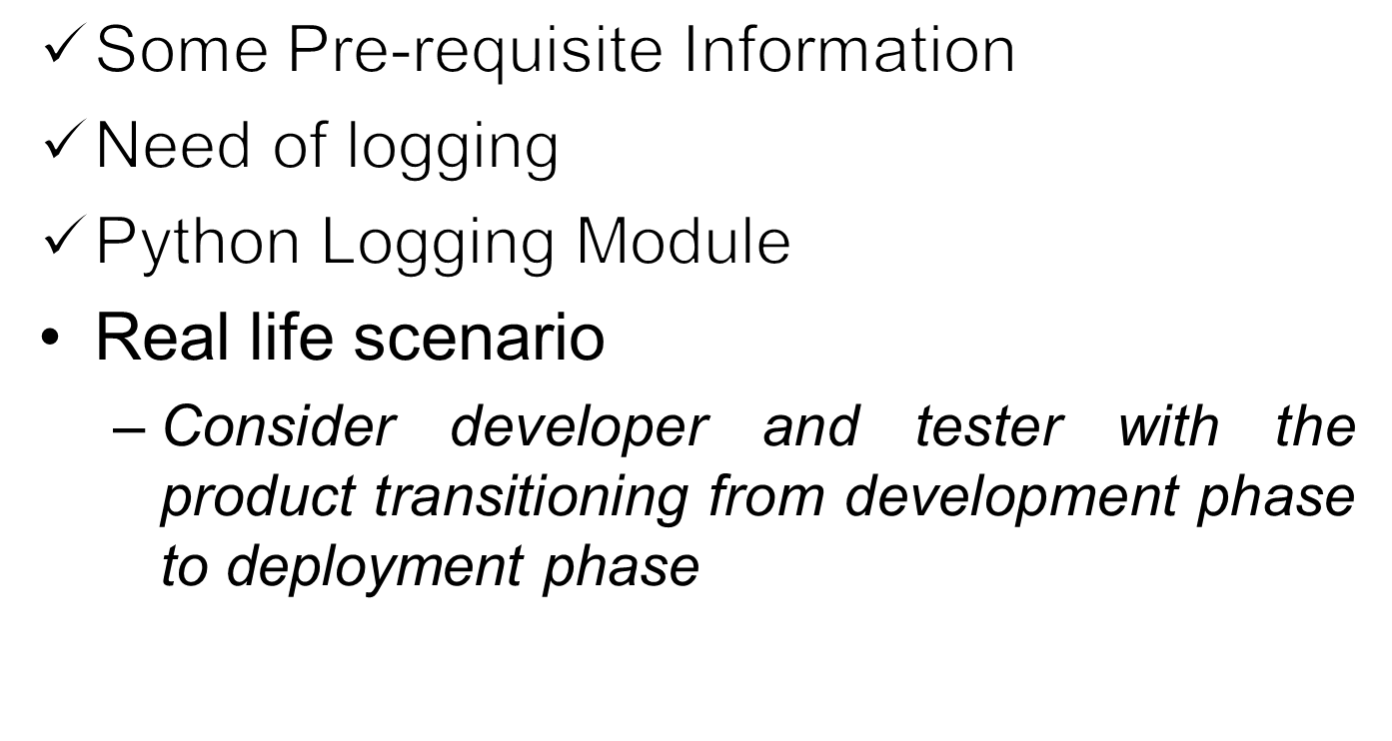
Progress

Slide 9

A Real Life Scenario

Slide 10
Conclusion
We understood some basic concepts about file, log, file logger
Practical Application and essence of logging
Real life scenario
Various logging levels
Implementation in python

